Slide 1


INTERNATIONAL STUDENT DATA ANALYSIS USING BIG DATA
TEAM MEMBERS
TANVI JAIN
SAIKUMAR REDDY PAPAGARI
AMARNADHA REDDY ANKIREDDYPALLI
NAGA MOUNIKA THOTAKURA

Slide 2
INTRODUCTION
This project focuses on extraction of dataset (Twitter Data) from the Twitter API regarding all the information related to international students and using different tools like Hive, Hue, Scala, pyspark, Spark SQL and Solr to show different aspects of the data in a visualization form using Tableau and Seaborn.

Slide 3
STUDYING ABROAD IS A JOURNEY OF EDUCATION AND DISCOVERY. THERE ARE CURRENTLY OVER 1 MILLION INTERNATIONAL STUDENTS FROM MORE THAN 220 COUNTRIES, COMING TO THE UNITED STATES ANNUALLY. THERE ARE NUMEROUS SITUATIONS WHERE WE ARE RELIED UPON TO FOLLOW THOSE STANDARDS WHICH THE OVERALL US CITIZENS ARE NOT EXPECTED TO FOLLOW IN THE LONG RUN SINCE, WE HAVE A PLACE WITH THE FOREIGNER GATHERING. SO, THIS GAVE US THE ESTABLISHMENT FOR THIS TASK, AND WE CHOSE TO FEATURE THE FUNDAMENTAL INFORMATION LIKE PERCENTAGE OF STUDENTS GOING TO THE UNITED STATES FOR EDUCATION, THE PROBABILITY OF GETTING A WORK VISA, IMMIGRATION RULES CHANGE FOR F-1 VISA DURING COVID, JOBS FOR INTERNATIONAL STUDENTS DURING COVID (H1B SPONSORSHIP).
MOTIVATION

Slide 4

SIGNIFICANCE:
Big data tools help to analyze the huge data which helps to provide efficient results. The sentimental analysis provides a brief understanding of various challenges that international students are currently facing and impact of covid-19 on the visa assurance. Finally, we are using Spark using python and Scala for writing the queries by visualization with Seaborn and Tableau.

Slide 5

OBJECTIVE
The objective of this project is to get twitter data extraction using Twitter Data Analysis and then cleaning the data, performing sentiment analysis, and importing files into Hadoop where we used different tools like Hue, Hive, Solr, Scala, Spark SQL and pySpark.

Slide 6
FEATURES
The main feature of the project is to collect the Real timed tweets from the twitter API, also by performing the ETL which means we preprocess the data using Texthero and extract the necessary data and then we load the extracted data in our HIVE. Performed topic modelling using LDA and genism model, visualized the top 4 topics by t-SNE visualization and performed analysis on data using PySpark, Solr and Scala.

Slide 7
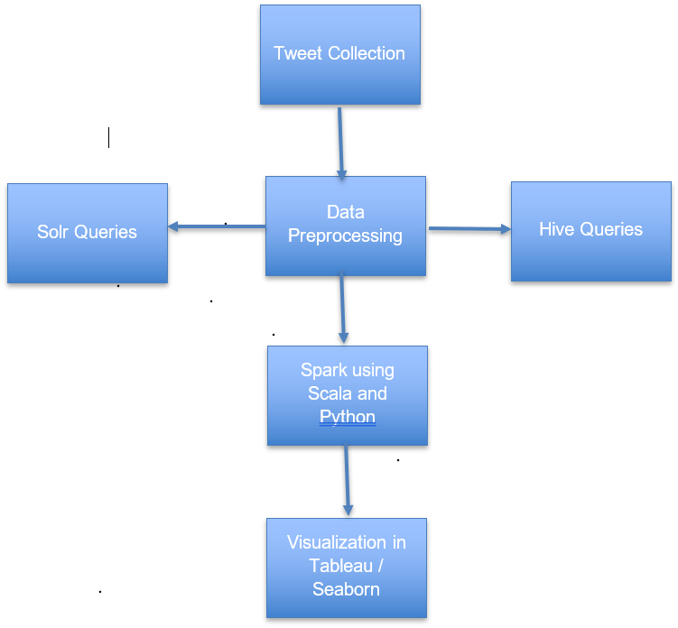
SIMPLE PROJECT FLOW

Slide 8
WORKFLOW
We have extracted dataset using twitter API, these datasets are extracted using different hashtags focusing on different events related
to international students, dividing the events and dataset is crucial since we want this project to be informational and focus on different aspects through different datasets. We will use sentiment analysis on the text (tweet) and use different queries to extract important features and visualize them in Tableau.

Slide 9
TOOLS & TECHNOLOGIES
PYTHON
HIVE
SOLR
SPARK
SCALA
SEABORN
TABLEAU

Slide 10

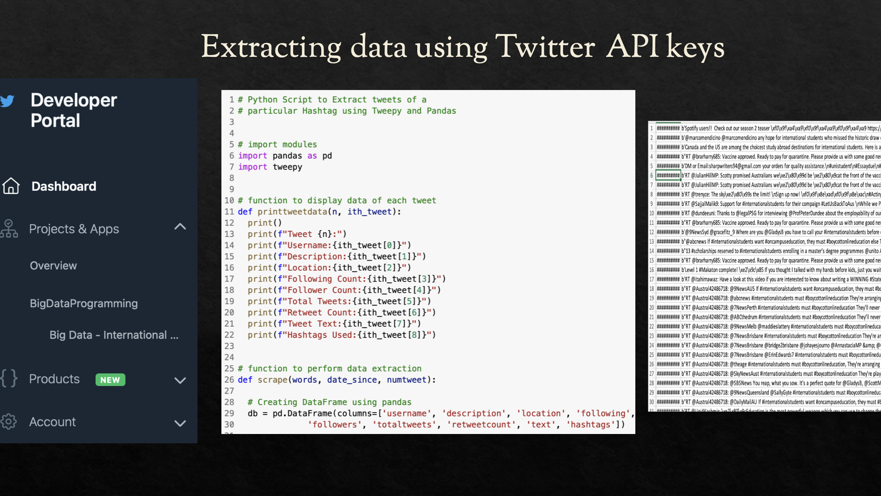
TWEETS EXTRACTION

Slide 11
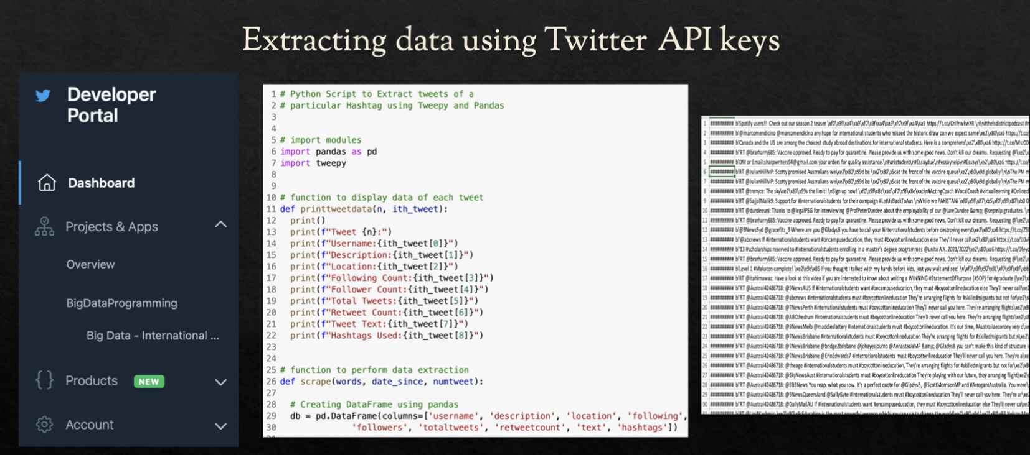

Slide 12
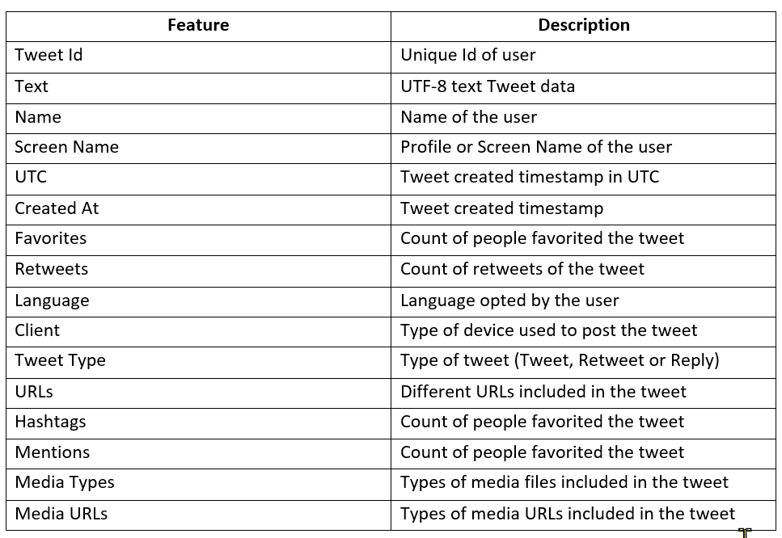
DATASET
We collected the data using twitter API using developer account and API keys. We have used different hashtags to get data related to 3 different scenarios as follows:
1. Generic International Student Data (#F1visa, #intlstudents, #internationalstudents, #studyinUSA)
2. Immigration rules change for F1 Visa during COVID in 2020 (#AbolishICE)
3. Jobs for international students during covid (H1B sponsorship) (#H1B, #h1bjobs) From the extraction we have the information about the tweet itself like this:

Slide 13
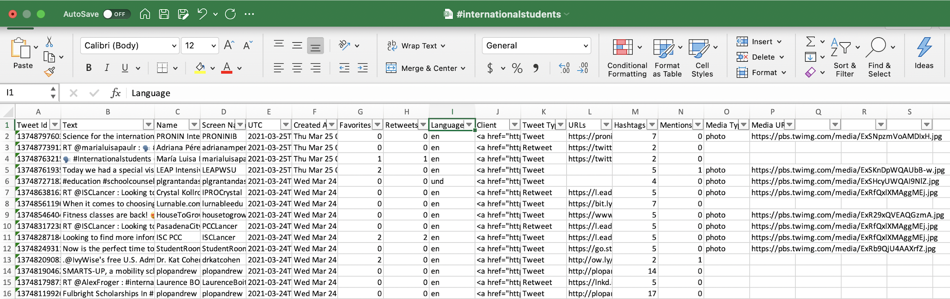
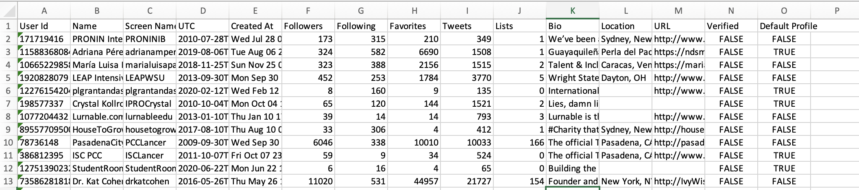
Data
We have extracted dataset using twitter API, these datasets are extracted using different hashtags focusing on different events related to international students, dividing the events and dataset is crucial since we want this project to be informational and focus on different aspects through different datasets. We will use sentiment analysis on the text (tweet) and use different queries to extract important features and visualize them in Tableau.
Figure: International Student Dataset

Slide 14
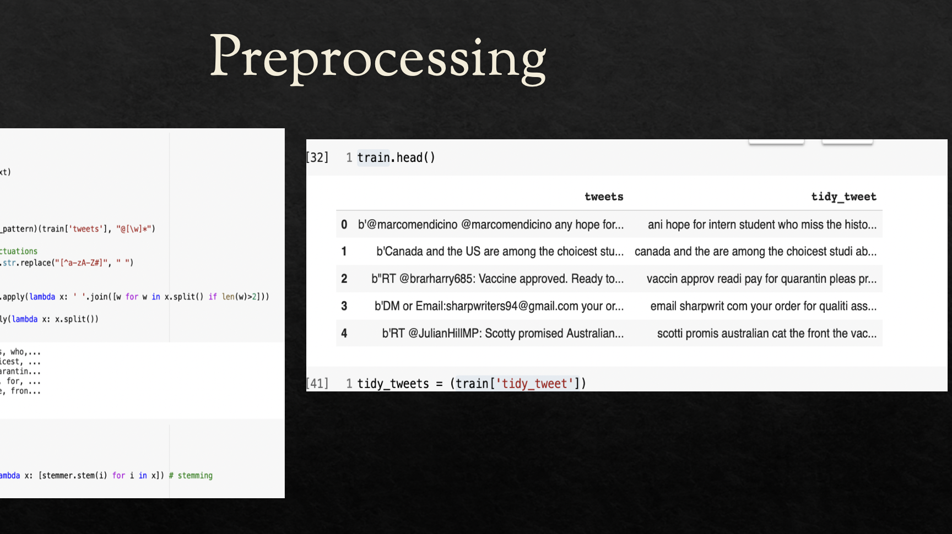
DATA PREPROCESSING

Slide 15
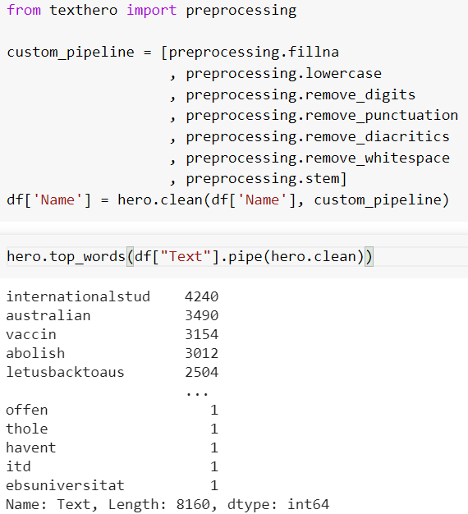
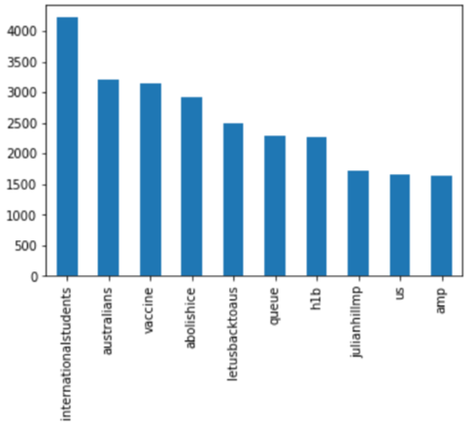
Top words from the data:

Slide 16

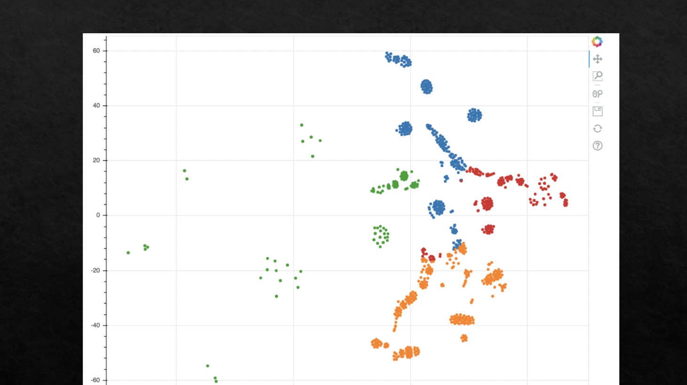
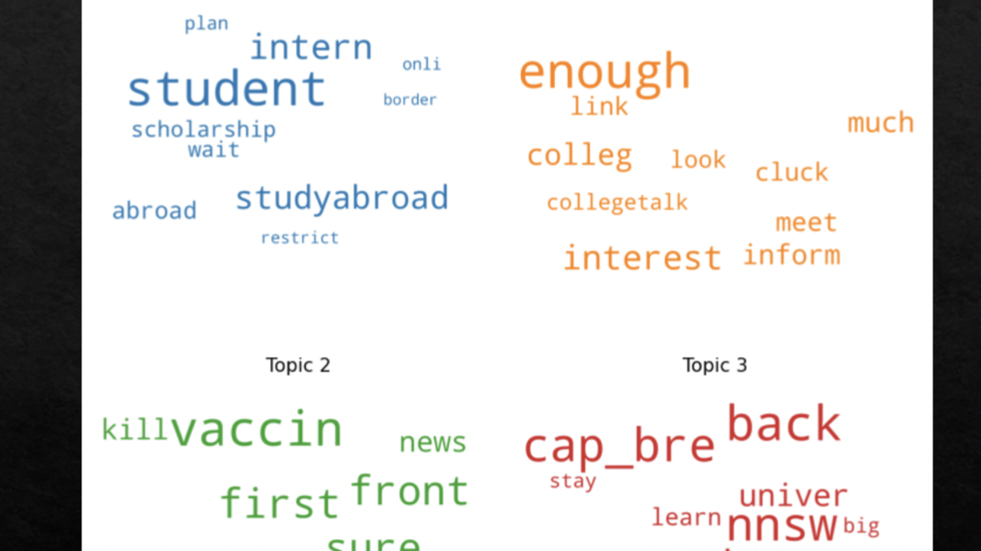
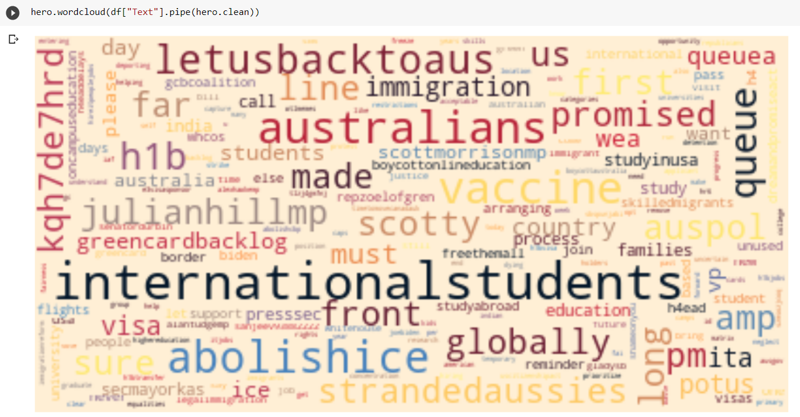
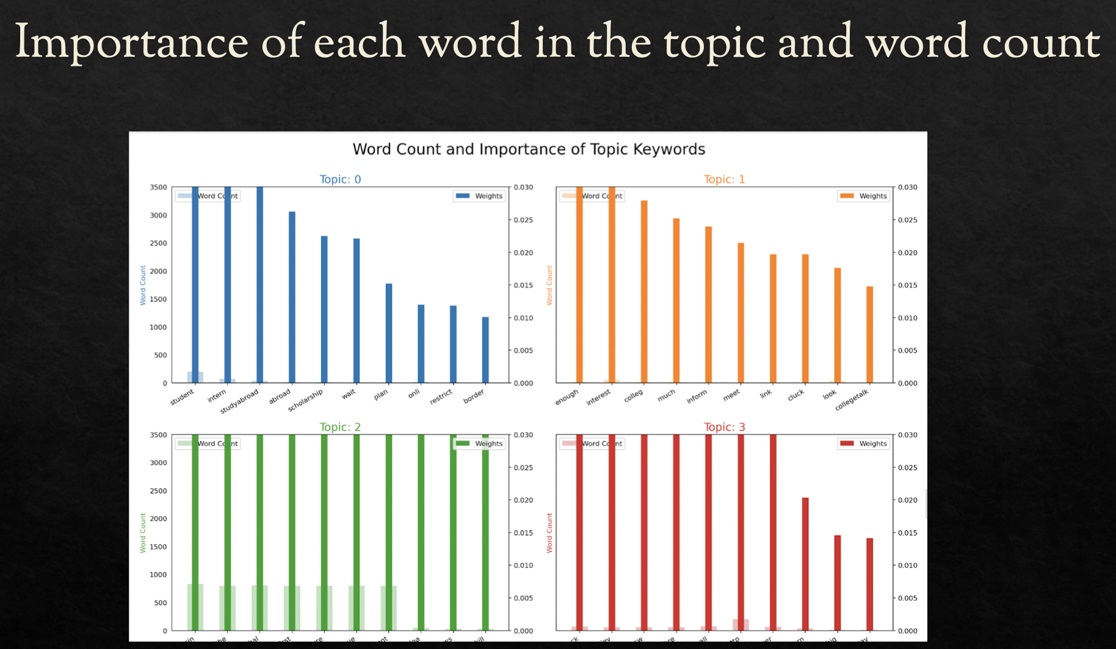
VISUALIZATIONS

Slide 17

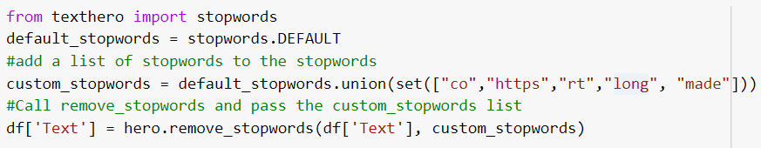
WORD CLOUD:

Slide 18
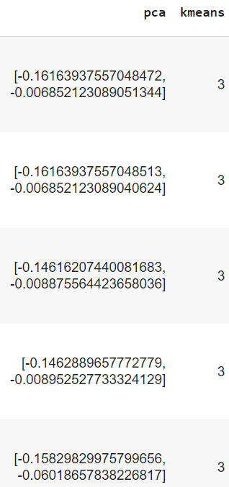
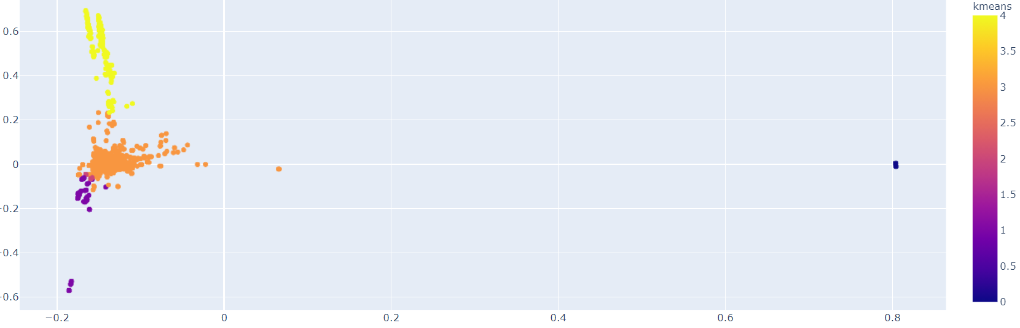
PCA and K-means Clustering:

Slide 19
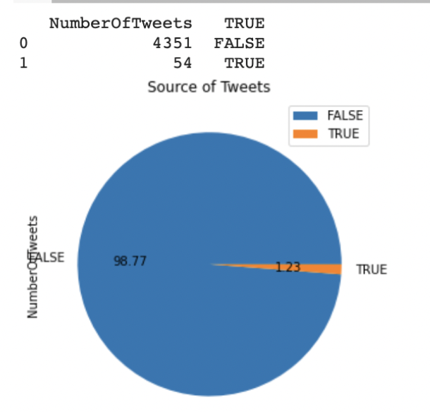
Pyspark & Spark sql for user data
Number of verified, and unverified users.

Slide 20
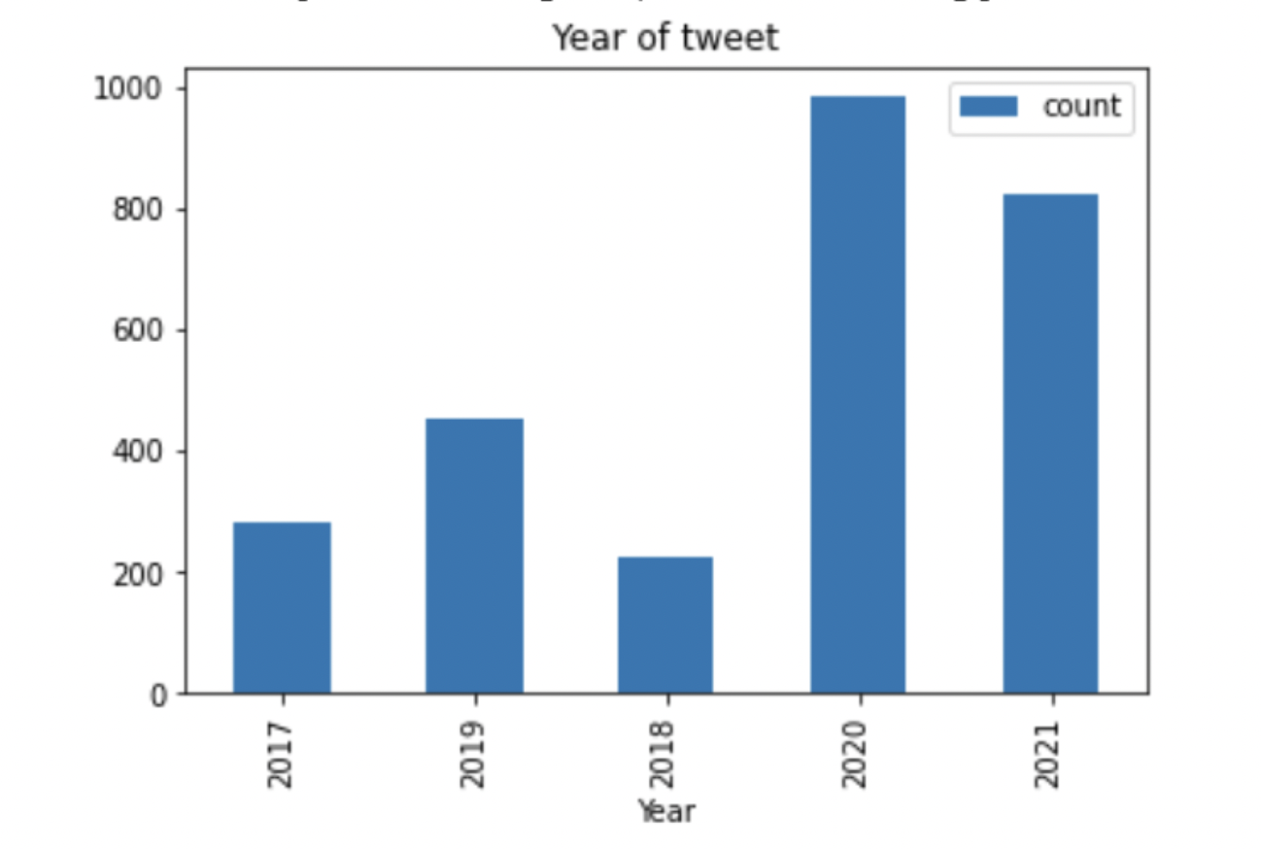
Highest number of tweets year
From this visualization it shows that there were more tweets in the year 2020 specifically as compared to other years since international students were in the talk in this year due to the corona pandemic, when ICE decided to change the immigration rules and h1b sponsorship was affected due to lack of jobs and recession.

Slide 21
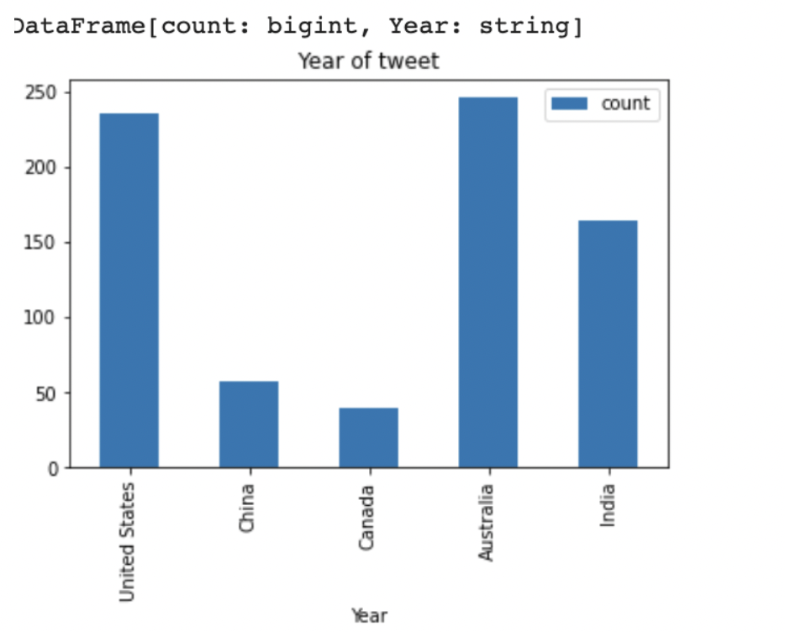
Countries that tweeted most and the least regarding international student scenario

Slide 22
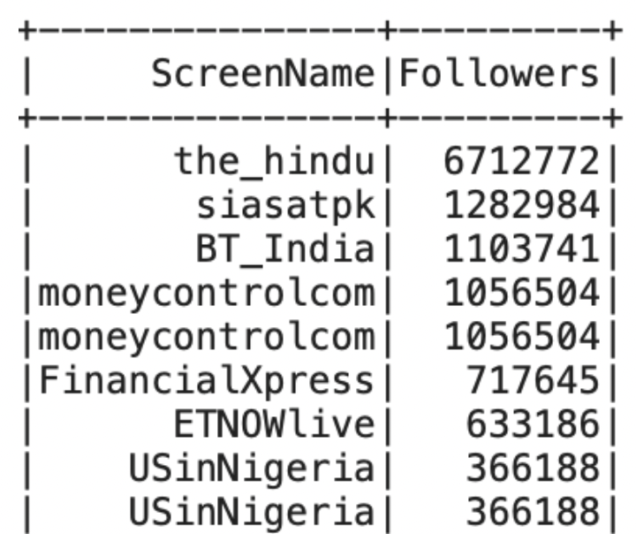
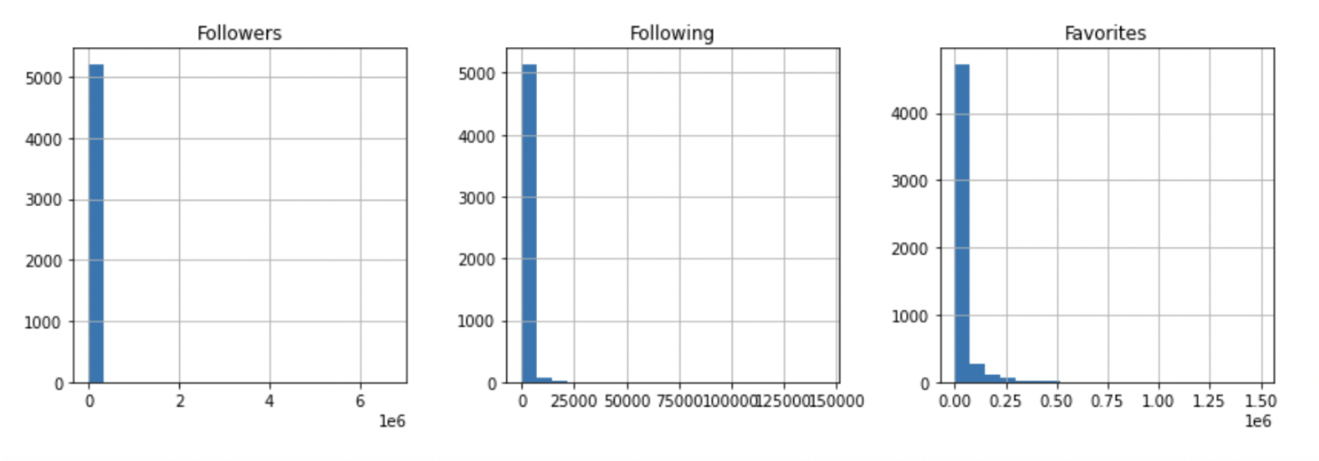
Influential people with highest following

Slide 23
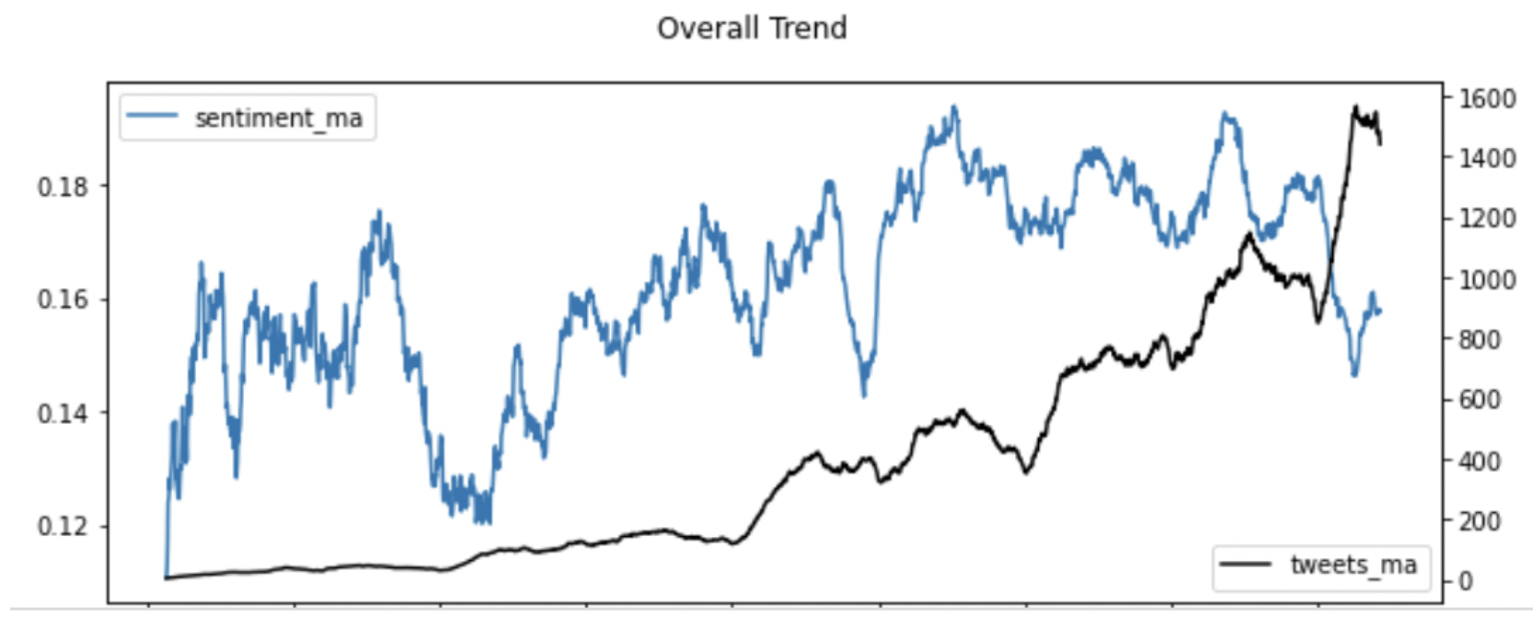
Sentiment Analysis Trend with time for the year 2020

Slide 24
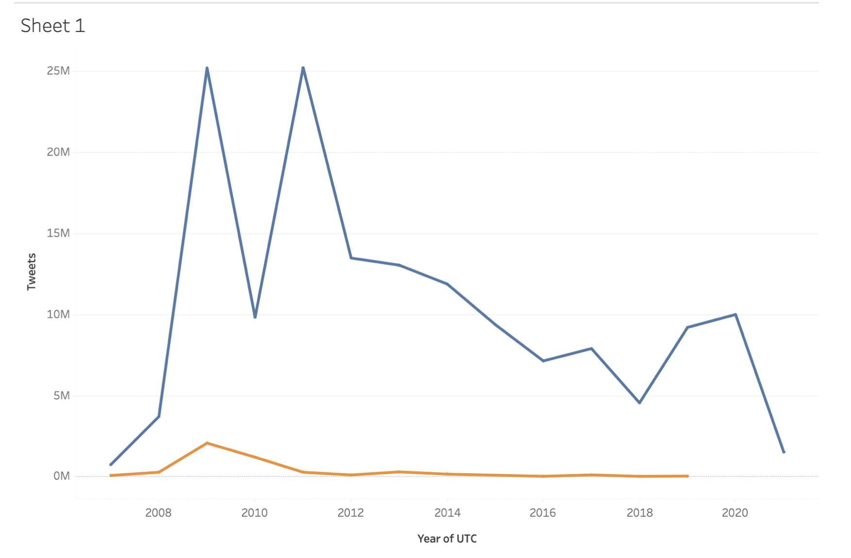
Tableau visualization of verified or unverified user

Slide 25
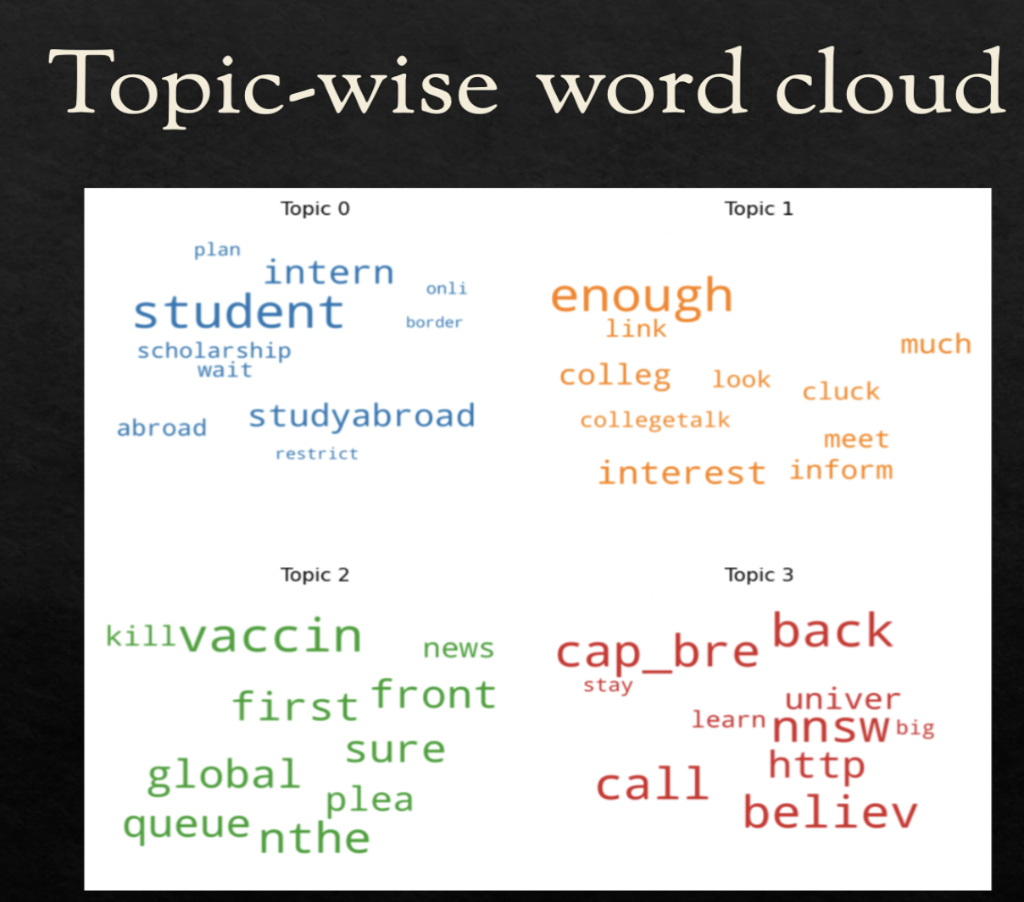

Slide 26
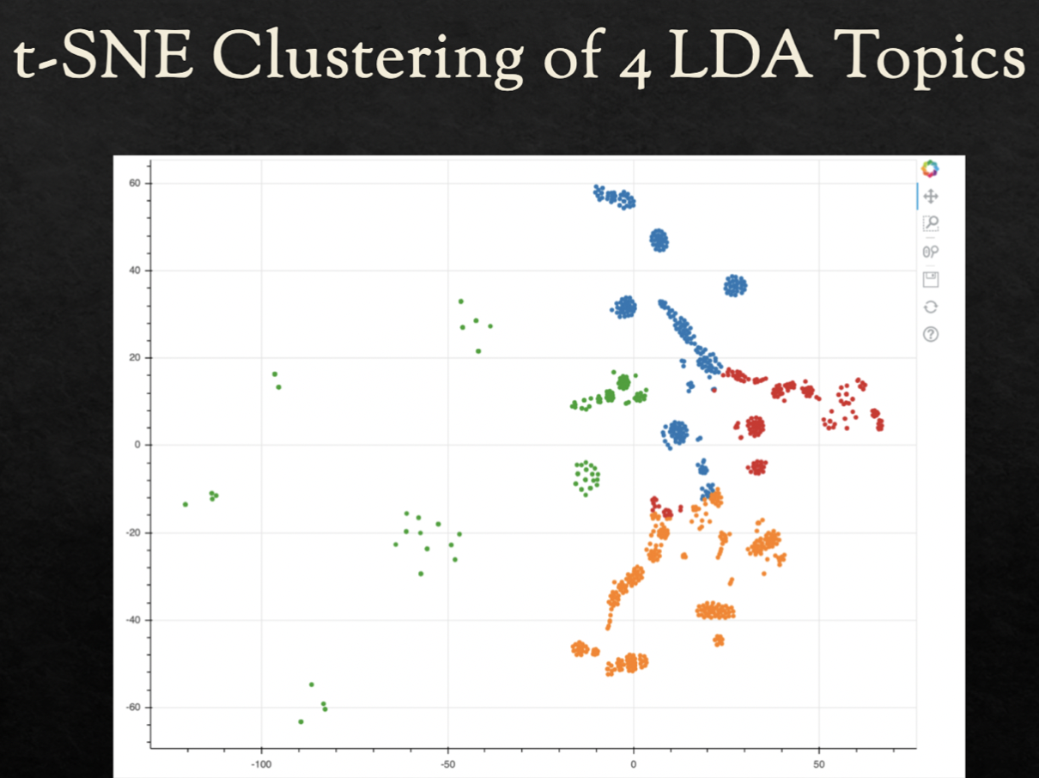

Slide 27
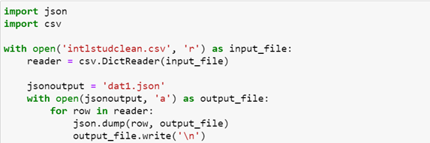
Converting working dataset (in .csv) to .json file.

Slide 28
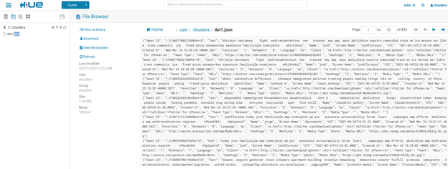
Place the .json file in the cloudera working directory

Slide 29
SPARK – SCALA ANALYSIS
Display the Username and Text of top 20 tweets.
Count the number of Media Types present in the dataset.
Fetching the different languages in which the tweets are made about international students.
Fetching users with a greater number of hashtags in their tweets on student data.
Fetching users who have more followers and are tweeting based on student data.
Fetching users with a greater number of mentions in their tweets on student data.
Fetching users having account names with a greater number of tweets on student data.

Slide 30
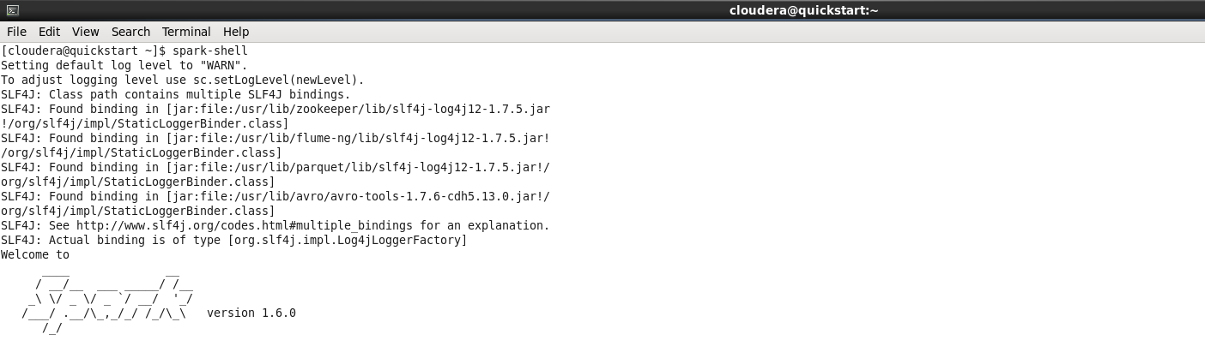
Start the Spark-shell

Slide 31
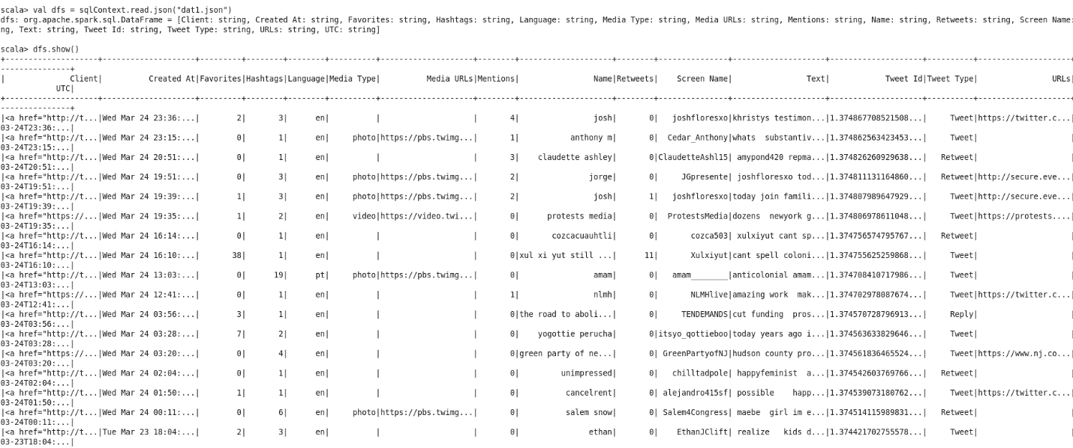
Here the data looks like:

Slide 32
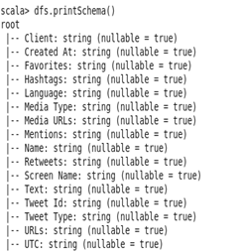
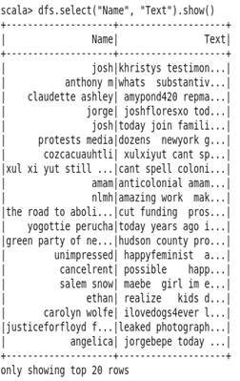

Slide 33
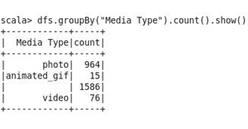
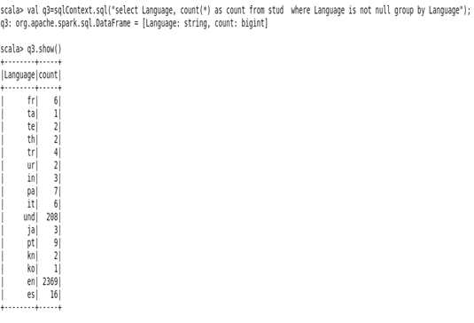
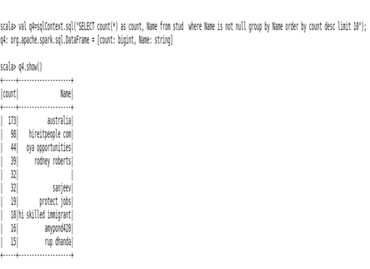

Slide 34
SPARK – PYTHON ANALYSIS
Display first 100 rows order by the Date tweeted.
Using the Union operation, count the number of tweets depending on the data sources.
Count the tweets by grouping them into languages and sorting them in descending order, starting with the top five.
Pull the top 10 users based on favorites count by dropping the duplicates
Pull the count of tweets based on the desired topics from the Text attribute.
Display the screen names of tweets that are mostly retweeted.
Display the screen name of tweets that has highest mentions.
Display the screen name of tweets that has most hashtags in it.
Plot the Users with the highest number of Media URLs.
Display the count of different types of tweets (Retweet, Reply or Tweet).

Slide 35
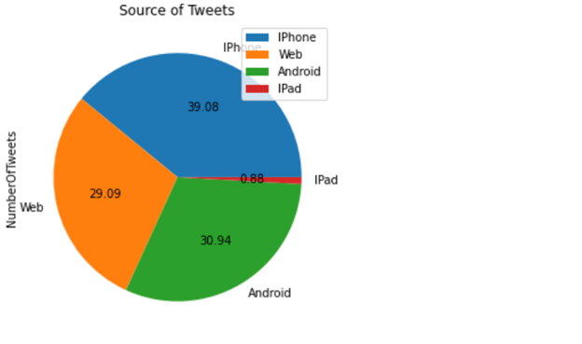
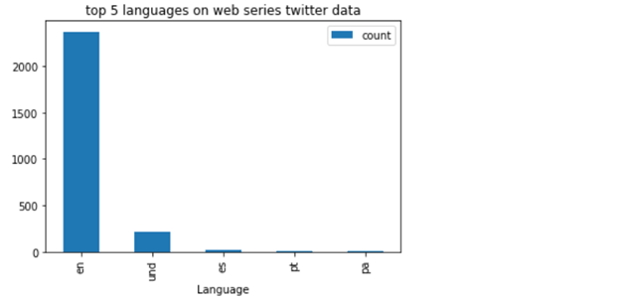
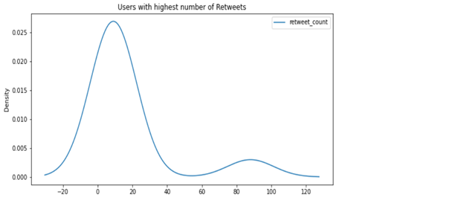
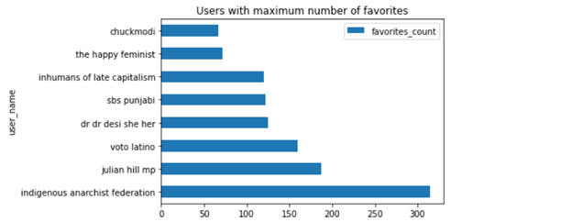
VISUALIZATIONS

Slide 36
Using the Union operation, count the number of tweets depending on the data sources.
Count the tweets by grouping them into languages and sorting them in descending order, starting with the top five.

Slide 37
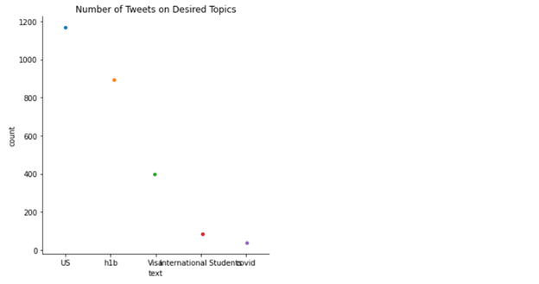
Pull the top 10 users based on favorites count by dropping the duplicates.
Pull the count of tweets based on the desired topics from the Text attribute.

Slide 38
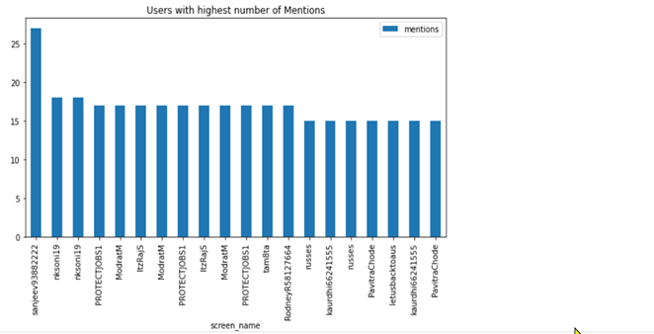
Display the screen name of tweets that has highest mentions.
Display the screen names of tweets that are mostly retweeted

Slide 39
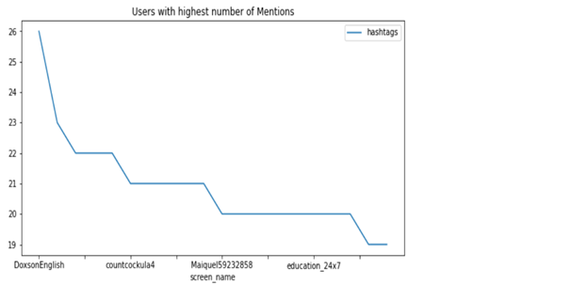
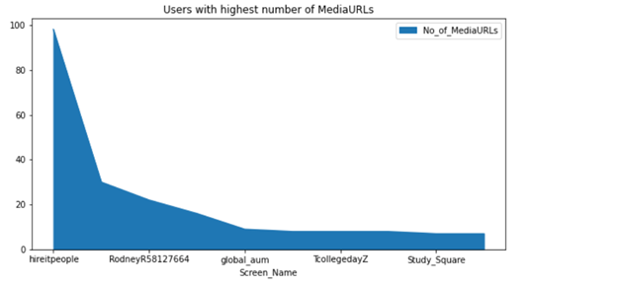
Plot the Users with the highest number of Media URLs.
Display the screen name of tweets that has most hashtags in it

Slide 40
SOLR ANALYSIS
Pulled the 10 records of data:
Pulled the tweets that are tweeted in English:
Pulled the data has 'F1Visa' included in the Text (Regex):
Collected the response with having Text:”student” and Text:”USA”:
Pulled the most retweeted tweets:

Slide 41
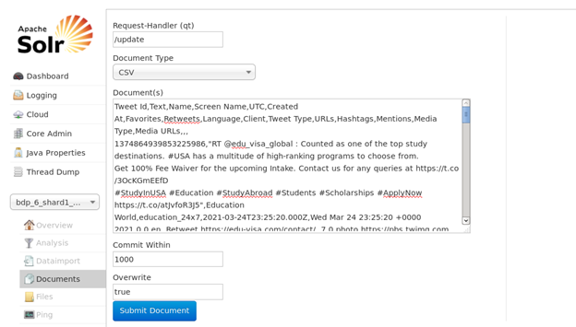
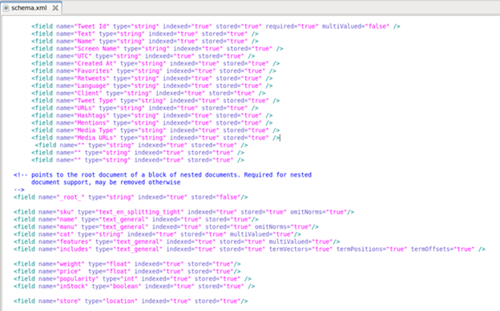
Edit the schema.xml created with the instance generation inside the configuration folder to change the attributes based on the dataset
Select the document type to csv. Then copy paste all the data inside the dataset into the documents field and submit the document

Slide 42
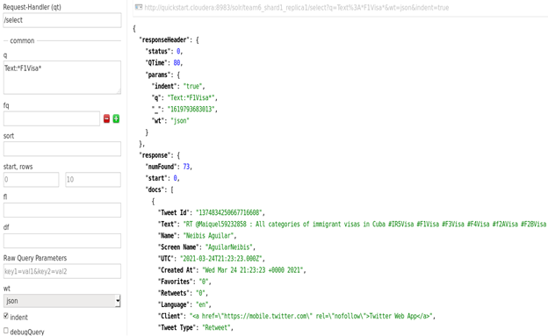
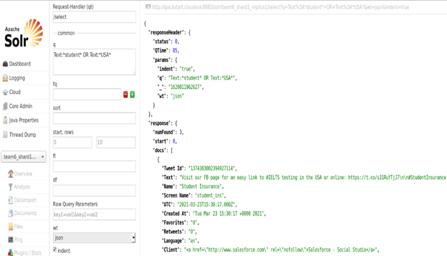
Pulled the data has 'F1Visa' included in the Text (Regex):
Collected the response with having Text:”student” and Text:”USA”:

Slide 43
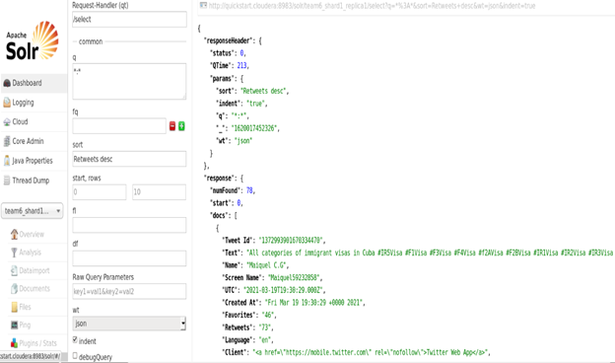
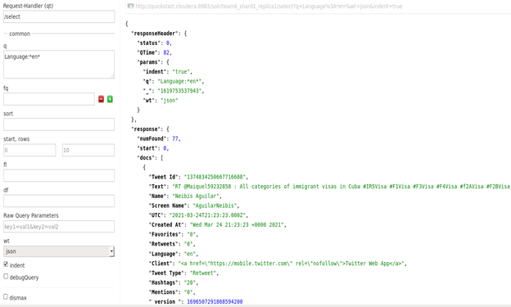
Pulled the most retweeted tweets:
Pulled the tweets that are tweeted in English:

Slide 44
HIVE ANALYSIS
Viewing the number of tweets based on h1b visa issues.
Viewing the number of tweets based on F1 visa issues.
Details of tweets regarding international students that have a greater favourites count.
Details of tweets regarding international students using orderby.
Viewing the details of tweet id from h1b.
Details of re tweets about h1b .

Slide 45
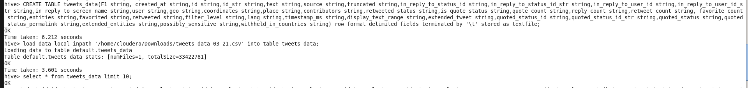
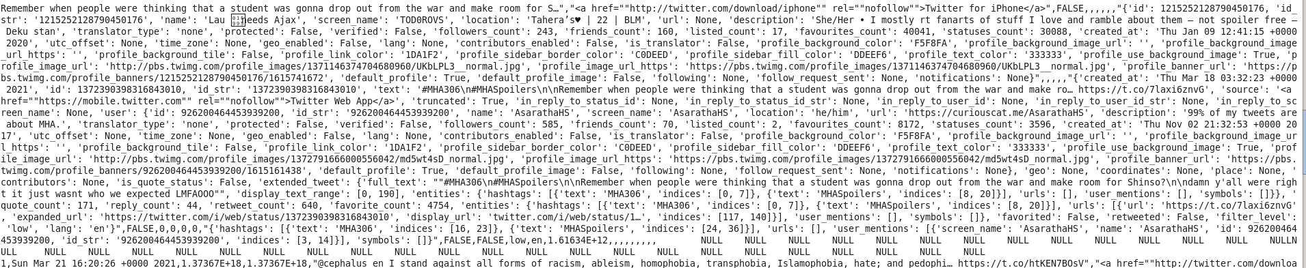

Slide 46





Slide 47



Slide 48



Slide 49
APPLICATIONS
To draw out the collective results.
To be able to visualize the statistics of the important events related to the international students
Analyse positive and negative opinion of people, sentiment, how the tweets were carried out.
Big data tools can be used to create a framework for analysis in an efficient way.

Slide 50
FUTURE WORK
Implementing the better Machine Learning Algorithms.
Working on more data sources such as Instagram, Facebook, and YouTube Data as well. Considering the project deployment in Docker.
Better use of the big data tools by targeting on a specific predefined and focused dataset.
A tool can be created using ML tools and analysis which on the basis of streaming tweets can tell the sentiments and prospective suggestions about a specific situation or crisis, which would help people calm down and be productive in the right track instead of panicking.

Slide 51
PROJECT MANAGEMENT
Description:
All the tasks that were lined up for the final project have been completed successfully in a timely fashion. We were able to implement different big data tools to analyse the data about international students and how they were impacted by the COVID situation and crisis.
Work Completed :
We have completed the extraction of dataset from twitter using twitter API, completed the tweets preprocessing part, sentiment analysis of those tweets. The data which was extracted was converted from csv to json format. We have also worked on Hive, Scala and pySpark to perform different analyzing techniques. Loaded dataset into solr to analyze various aspects from the data. Visualized the results using Tableau and Seaborn.

Slide 52
TEAM RESPONSIBILITIES
● Twitter data streaming (Tanvi, Mounika)
● Data processing (Tanvi, Amar)
● Conversion of csv to json (Saikumar)
● Spark streaming using Scala (Saikumar)
● Solr execution and queries (Amar)
● pySpark queries and plotting (Amar, Tanvi)
● Word cloud, PCA and k-means clustering using Texthero (Amar)
● Hive implementation (Mounika)
● Visualization in Seaborn (Amar)
● Word Cloud using pyspark (Tanvi)
● Topic modelling to find dominant terms (Tanvi)
● TSNE clustering & Visualization in Tableau (Tanvi)
● Sentiment analysis and trend analysis in pyspark(Tanvi)

Slide 53
CONCLUSION
Done the data extraction using Twitter API for different hashtags and implemented them in various Big Data tools like Hive, Spark and PySpark.
The visualization is done using PySpark in the form of bar graphs, pie-charts, and scatter plots. The sentiment analysis of the tweets is performed using pyspark and some visualization is done using different tools like TSNE and tableau.
The results show that the international students were talked about and were the highlight of the tweets specially during the immigration change.
There were many languages in which the tweets were performed, and from more than 20 different countries.

Slide 54
REFERENCES
https://towardsdatascience.com/try-texthero-the-absolute-simplest-way-to-clean-and-analyze-text-in-pandas-6db86ed14272
https://docs.cloudera.com/documentation/enterprise/6/6.3/topics/cm_mc_solr_service.html
https://spark.apache.org/sql/
https://www.tutorialspoint.com/spark_sql/spark_sql_dataframes.html
https://docs.cloudera.com/runtim/7.2.7/search-managing/topics/search-updating-the-schema-in-a-solr-collection.html
https://github.com/dsuarez993/bigdata-realtime-twitter-analysis
https://github.com/6vedant/TwitterAnalyticsHadoop
https://www.toptal.com/apache/apache-spark-streaming-twitter
https://hadoop.apache.org/

Slide 55
THANK YOU

